Slide 1
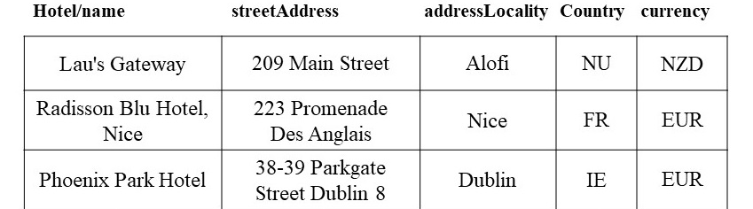
Table Annotation using Deep Learning
Millions of tables are found on the Web:
Important data source for gathering information about products, companies, …
The integration of table data can be hard due to heterogeneity in their schema and data representation
Table Annotation:
Annotating a table with terms/concepts from a knowledge graph or vocabulary
Crucial step in table data integration process
Transformer-based Table Annotation:
Pre-train models on large data corpora, fine-tune them for table annotation tasks
Serialization of column content as well as context columns for table annotation
Knowledge graph /Vocabulary
Example: Annotating a table from the WDC Schema.org Table Corpus
How to best use Transformer-based models for table annotation?

Slide 2
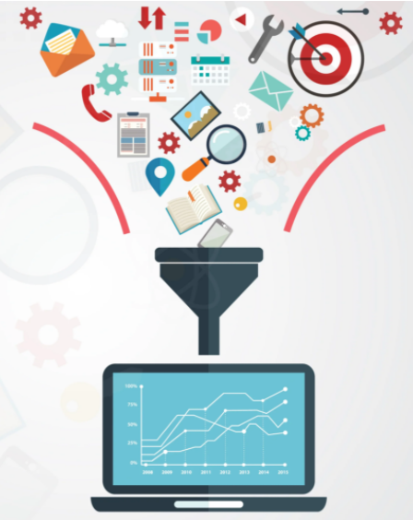
Table Annotation using Deep Learning
Project Goal
Experiment with different pre-training, fine-tuning, and data augmentation techniques
for Table Annotation using the SOTAB Benchmark
Involves
data profiling/pre-processing
model training, evaluation, selection, and iteration
Learning Targets
gain experience with using state-of-the-art deep learning techniques (Transformers, contrastive learning)
deal with large-amounts of heterogenous data
Requirements
data wrangling skills, programming skills (Python, Huggingface)
relevant courses: Web Data Integration, Data Mining I & II, Text Analytics recommended
Organization: 4-6 people, 6 months, work as a complete team and in subgroups
Instructors: Keti Korini, Christian Bizer

Slide 3
Table Annotation using Deep Learning
References for getting into the topic:
[1] Suhara, Y., Li, J., Li, Y., Zhang, D., Demiralp, Ç., et al. “Annotating columns with pre-trained language models.” In Proceedings of the 2022 International Conference on Management of Data, 2022, pp. 1493–1503
[2] X. Deng, H. Sun, A. Lees, Y. Wu, and C. Yu, “TURL: table understanding through representation learning,” Proc. VLDB Endow., vol. 14, no. 3, Nov. 2020, pp. 307–319.
[3] N. Tang et al., “RPT: Relational Pre-trained Transformer Is Almost All You Need towards Democratizing Data Preparation,” arXiv:2012.02469 [cs], Mar. 2021
[4] https://paperswithcode.com/task/table-annotation
[5] https://www.cs.ox.ac.uk/isg/challenges/sem-tab/

