Slide 1
Development of a Blockchain-based Platform for Survey and Experiments
Team Project Spring 23
Chair of Data Science in the Economic and Social Sciences
Supervisor: Dr. Stefano Balietti

Slide 2
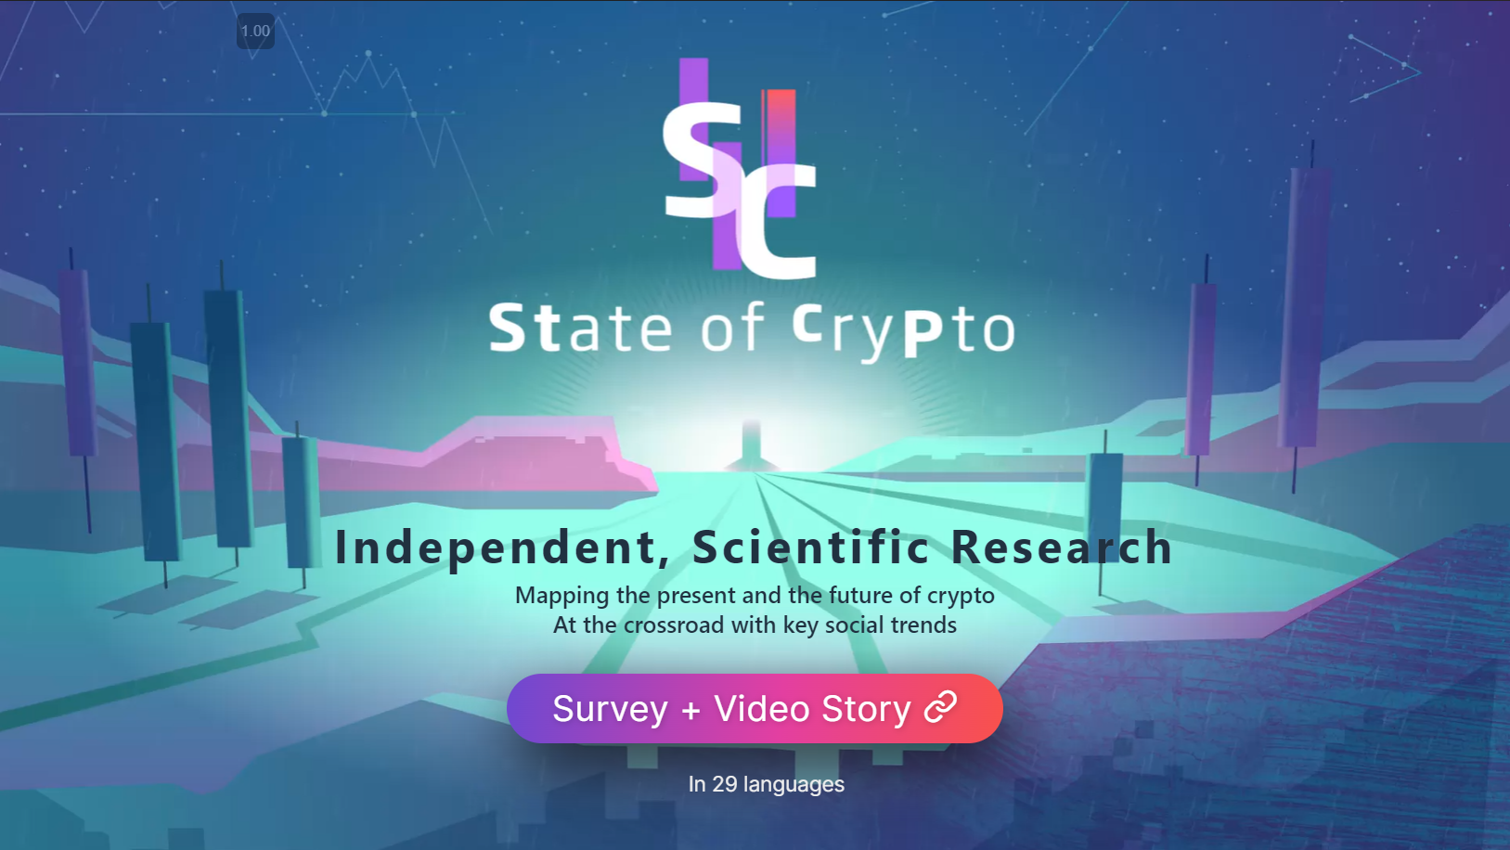
State of Crypto Survey 2022
https://stateofcrypto.net

Slide 3
State of Crypto Survey 2022
https://stateofcrypto.net

Slide 4
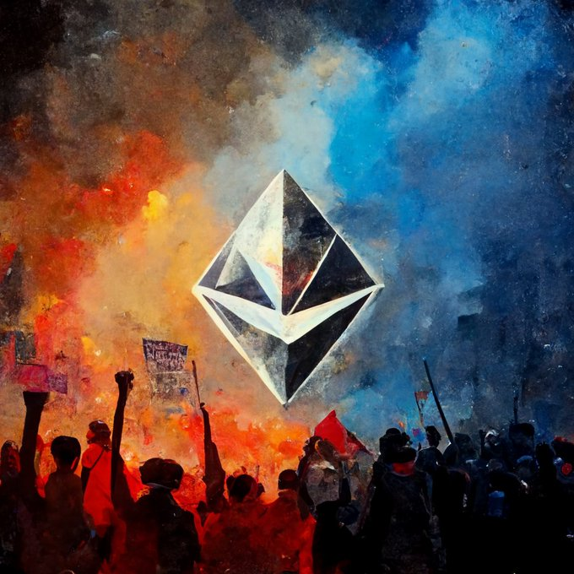
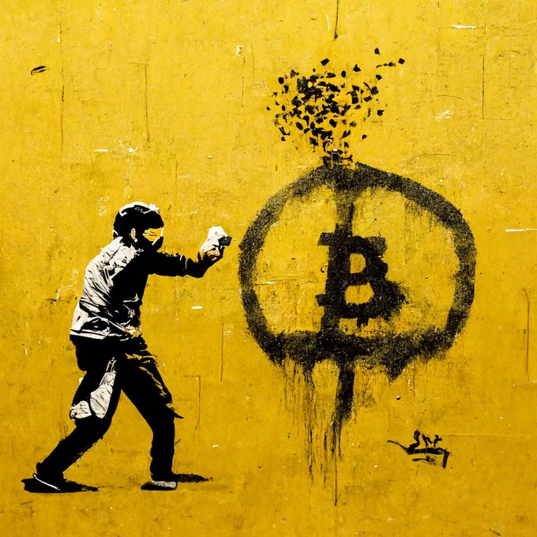
Blockchain-based Platform for Survey and Experiments
Part 1: You will create Web3 infrastructure to:
Store sensitive and non-sensitive information on the blockchain
Share information with authorized parties (e.g., researchers)
Prevent bots and Sybil attacks (e.g., https://proofofhumanity.id/)
Allow researchers to filter, notify, recruit, and pay partcipants of studies
Automate payments on L2 (E.g., Polygon)

Slide 5
Blockchain-based Platform for Survey and Experiments
Part 1: You will create Web3 infrastructure to:
Store sensitive and non-sensitive information on the blockchain
Share information with authorized parties (e.g., researchers)
Prevent bots and Sybil attacks (e.g., https://proofofhumanity.id/)
Allow researchers to filter, notify, recruit, and pay partcipants of studies
Automate payments on L2 (E.g., Polygon)
Part 2: You will model the economic incentives for a community of scientists and research participants:
Develop tokenomics (including airdrop of tokens) for interested parties
Launch DAO on Snapshot.org (https://snapshot.org)
Integrate with with community managed software (e.g., Discord)

Slide 6
Blockchain-based Platform for Survey and Experiments
Part 1: You will create Web3 infrastructure to:
Store sensitive and non-sensitive information on the blockchain
Share information with authorized parties (e.g., researchers)
Prevent bots and Sybil attacks (e.g., https://proofofhumanity.id/)
Allow researchers to filter, notify, recruit, and pay partcipants of studies
Automate payments on L2 (E.g., Polygon)
Part 2: You will model the economic incentives for a community of scientists and research participants:
Develop tokenomics (including airdrop of tokens) for interested parties
Launch DAO on Snapshot.org (https://snapshot.org)
Integrate with with community managed software (e.g., Discord)
If successful, your code will run the State of Crypto Survey 2023 (Oct-Dec)

Slide 7
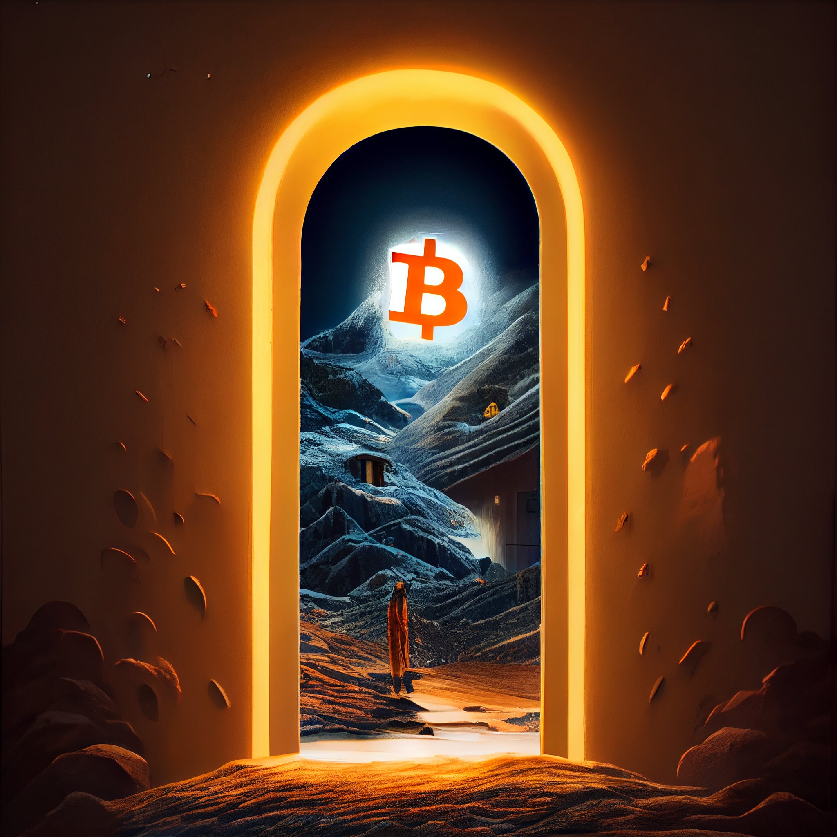
What Real-World Problem are you going to solve?
Democratizing access to research participants world-wide
Reduction of fees => more budget for research more money for participants!
Speed up scientific knowledge creation by allowing responsible access to information about participation in previous research
Fair and transparent rules for data sharing and re-use

Slide 8
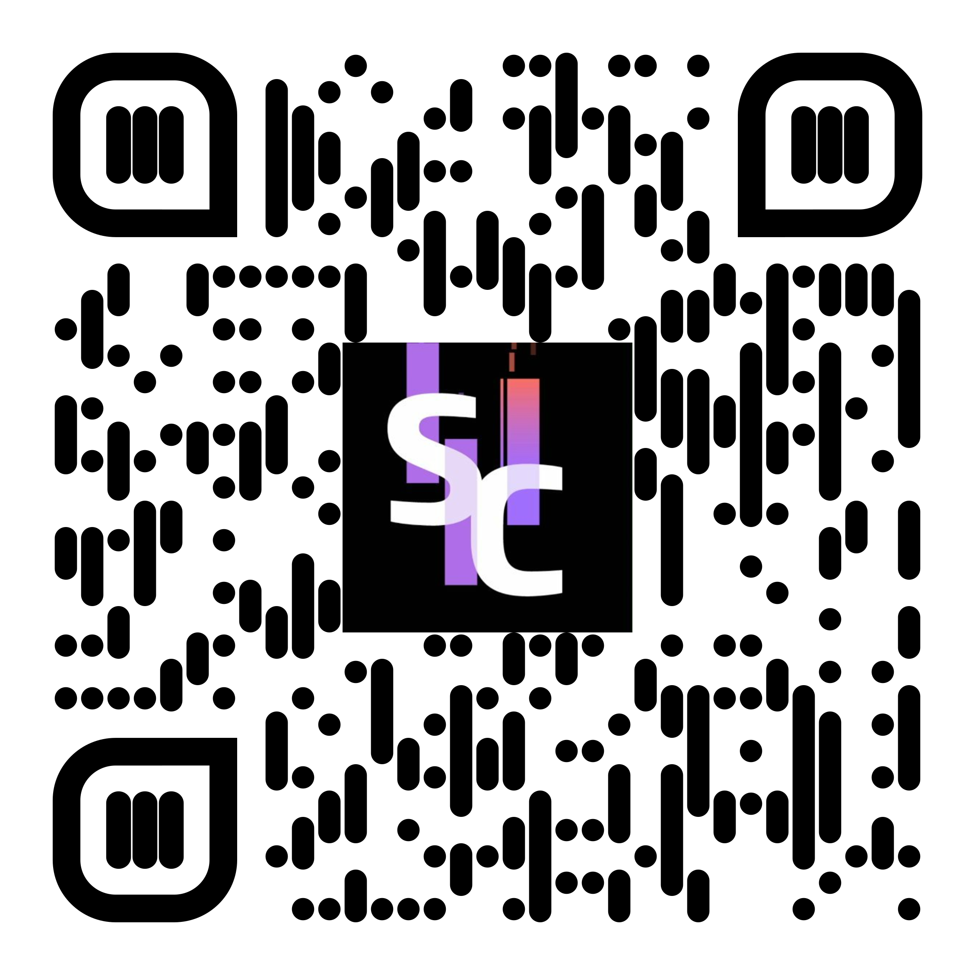
Logistics
Responsible person: Dr. Stefano Balietti
Language: English
Duration: 6 months
Min/Max number of participants: 2-6
Prerequisites:
Part 1: Strong programming skills, understanding of software engineering, knowledge of (or willingness to learn quickly) JavaScript/Node.js and Solidity
Part 2: Fair understanding of Behavioral Game Theory and Statistics, average programming skills
Work process:
Regular meetings with supervisor
Monthly (at least) presentations to follow up progress
Written report to be submitted at the end (including software documentation)

