Slide 1
Biases in Online Football Discussions
Team Project Spring/Summer 2023
Chair of Data Science in the Economic and Social Sciences
Supervisors: Tobias Schumacher, Dr. Max Pellert

Slide 2
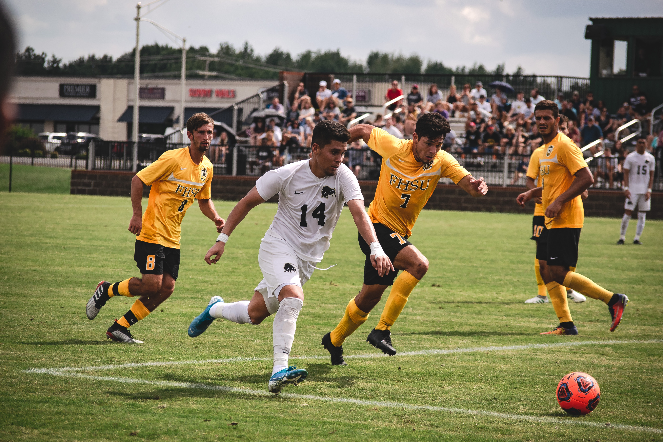
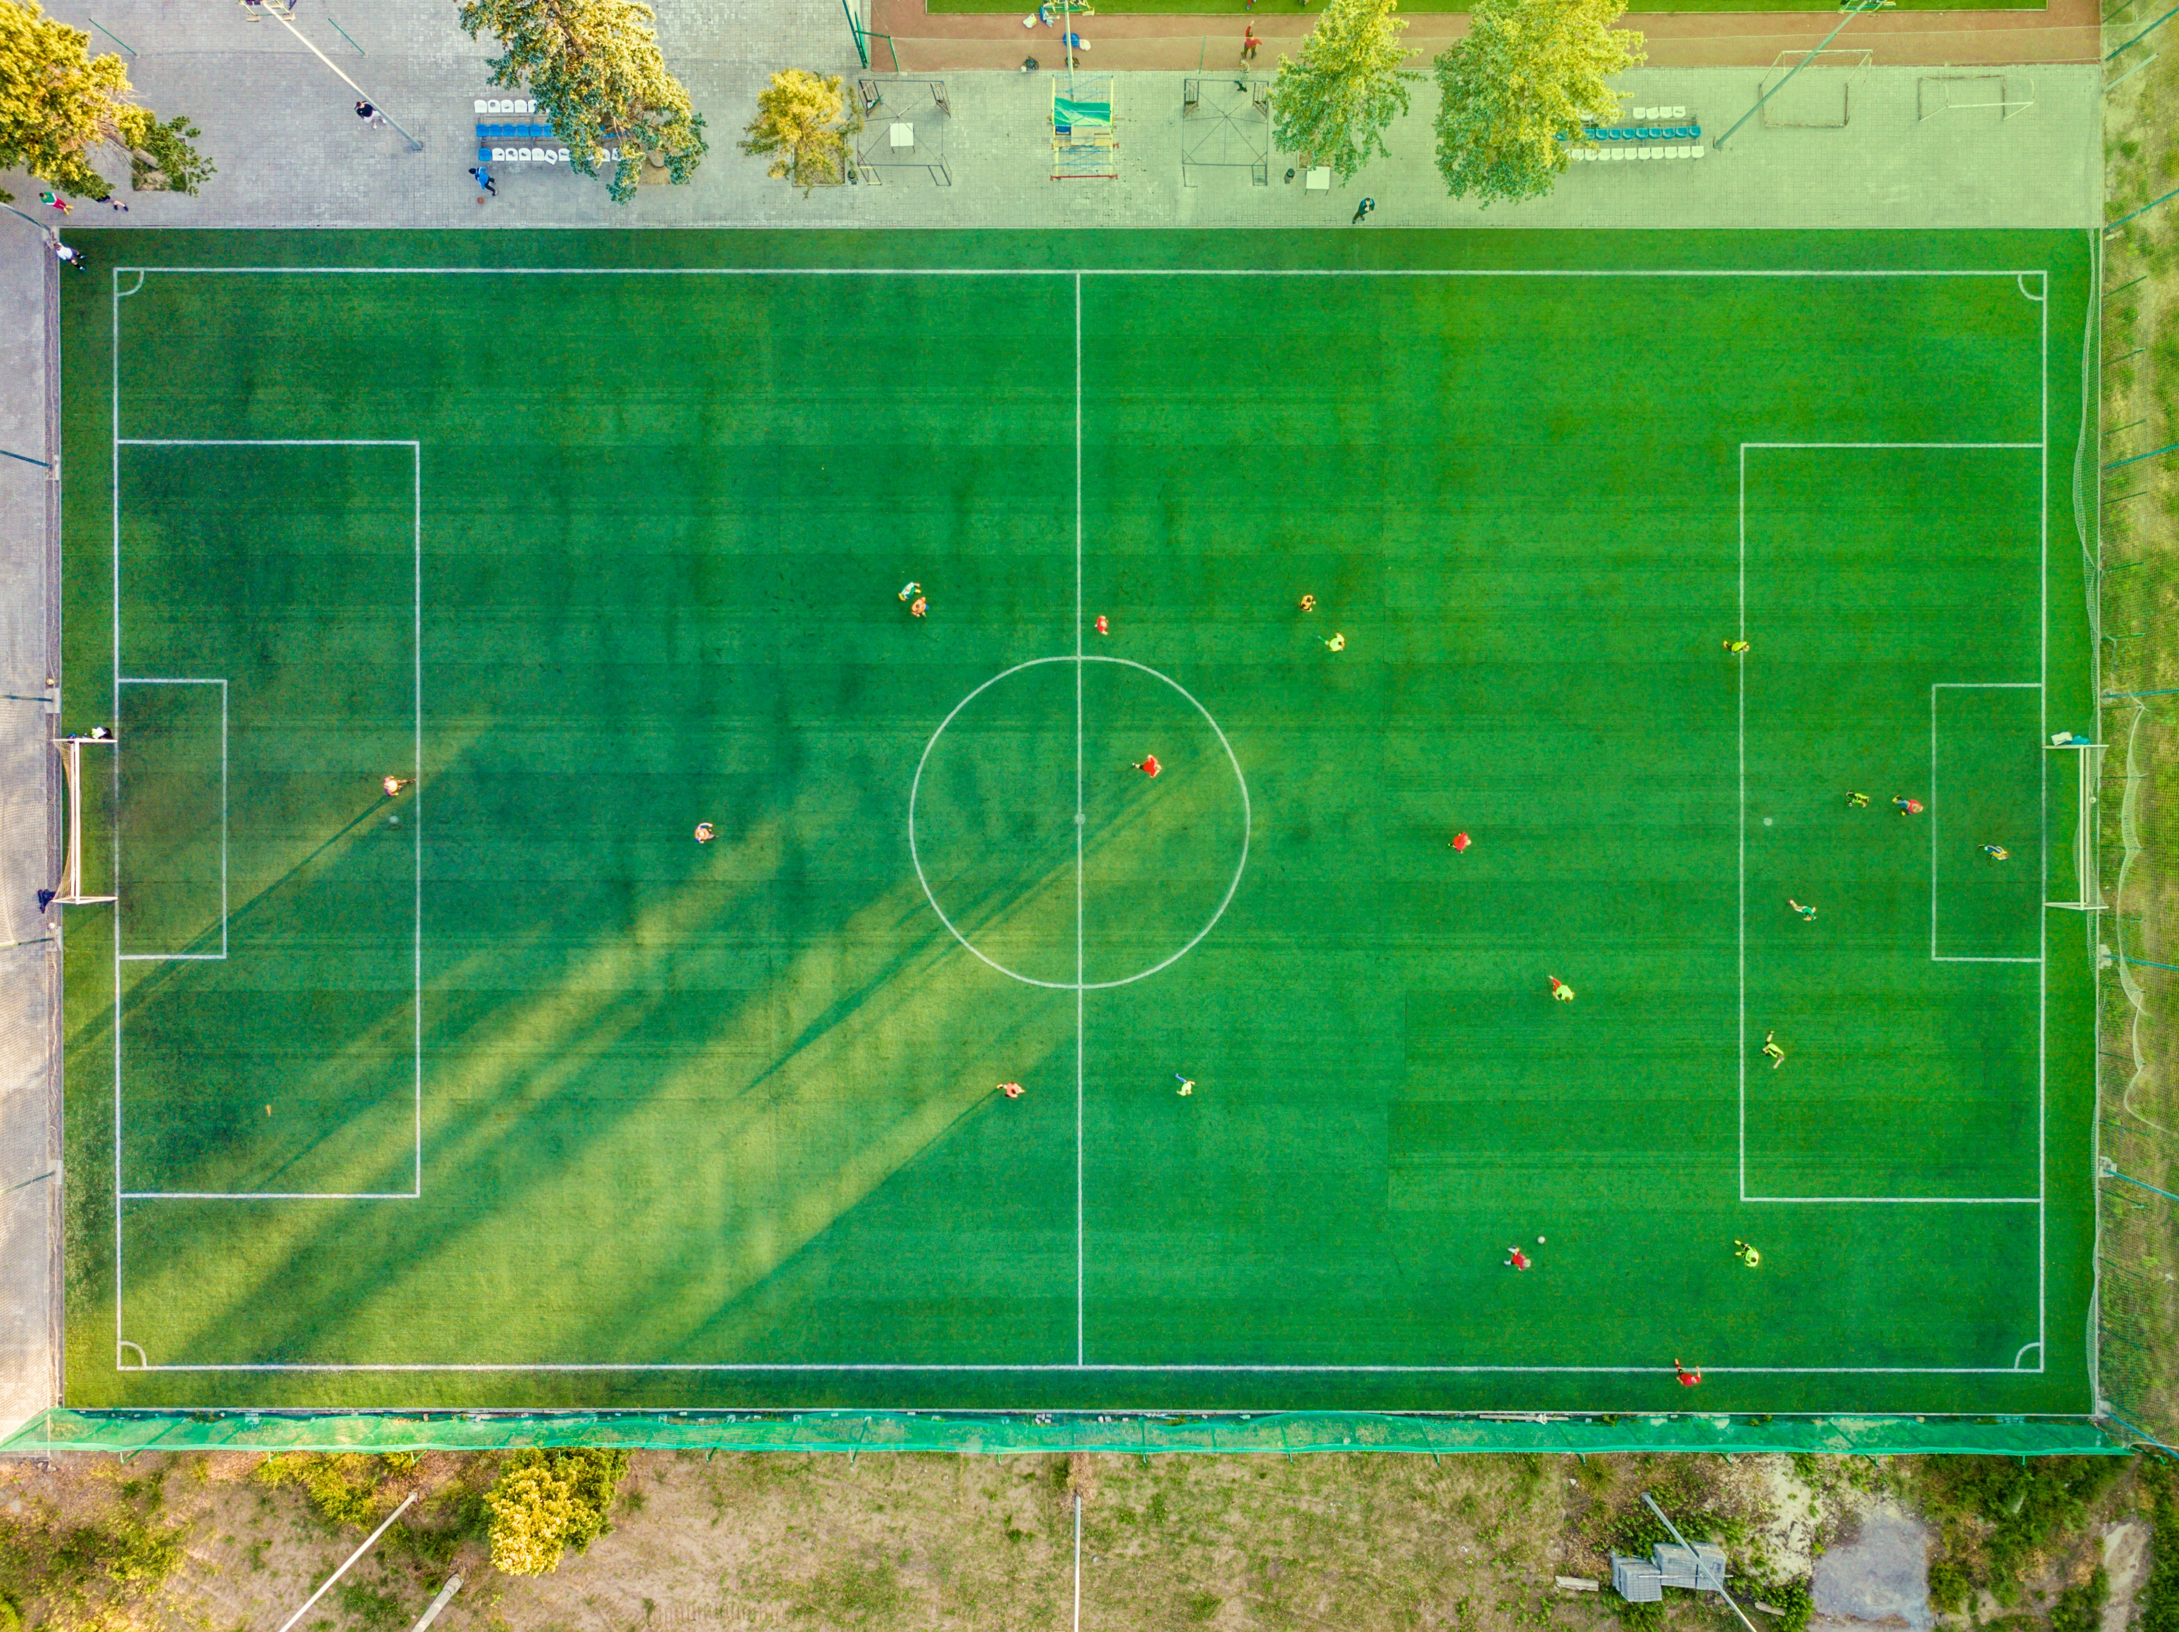
Biases in Online Football Discussions
Football is probably the most popular sport in the world
Recent world cup final watched by 1.5 billion people according to FIFA¹
Naturally, football is also a very popular conversation topic in online communities
[1] https://www.fifa.com/tournaments/mens/worldcup/qatar2022/news/one-month-on-5-billion-engaged-with-the-fifa-world-cup-qatar-2022-tm

Slide 3
Biases in Online Football Discussions
Problems and Biases in Football Fandom
Huge gap in popularity between men‘s and women‘s football
Also, rivalism often taken too seriously, violence between fans still a problem
Issues like racism or homophobia still very common in football stadiums and even among players around the world
Such biases also carry over to online discussions, or also supposedly neutral TV commentators
However, not that much research present over these phenomena

Slide 4
Biases in Online Football Discussions
RunRepeat Study² (2020)
Study Analyzed football commentary of 80 matches in 4 European football leagues
Found discrepancies in the way players were talked about based on their skin tone
Over 60% of all praise aimed at players with lighter skin tone, over 60% of criticism aimed at players with darker skin tone
Darker skin players much more reduced to physical attributes such as speed and strength
[2] https://runrepeat.com/racial-bias-study-soccer

Slide 5
Biases in Online Football Discussions
Data Analysis: Who is bothered by Women‘s Football?
Max has recently scraped a dataset of 2.8 million Tweets on the European Championships of men in 2021 and women‘s soccer in 2022 for three different languages
Initial analysis found discrepancies in the way people expressed emotions in comments on men‘s and women‘s soccer

Slide 6
Biases in Online Football Discussions
Research Problem
The goal of this project is to analyze biases in football discussions in online communities
Several online platforms possible, such as
Twitter (API shut down though)
Reddit (pushshift API)
Transfermarkt.de (needs to be scraped)
Broad range of potential analyses could be considered
Biases based on skin tone or nationality of players
Discrepancies between commentary on men‘s and women‘s football
Potential differences ov platforms or countries/languages
Max‘s dataset potential starting point
You are free to discuss your ideas with us!

Slide 7
Biases in Online Football Discussions
Research Problem – Data, Tools, Challenges
Potentially huge amounts of data requires good organization, clear analysis pipeline
Has to be implemented in Python (or R or using command line tools)
Scraping data from the web may take time to set up and run
Need to familiarize with text processing tools such as sentiment analyzers, open NLP libraries as provided by HuggingFace

Slide 8
Biases in Online Football Discussions
Brief Logistics
Language: English
Duration: 6 months
Min/Max number of participants: 3-5
Prerequisites: Strong programming skills, knowledge in machine learning/statistical data analysis, web mining and/or text analytics
Work process:
Lots of Coding, Data Processing and Analysis
Regular meetings with supervisors, present and discuss your progress
Present your final result in an endterm presentation meeting
Written reports to be submitted at the end

