Slide 1
Team Projects HWS 2023
Chair of Artificial Intelligence

Slide 2
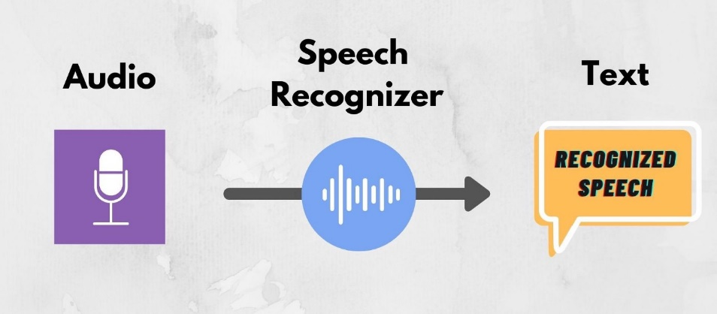
Designing and Building an Automatic Speech Recognition Demonstrator for the General Public

Slide 3


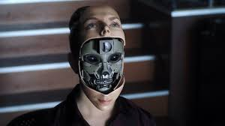
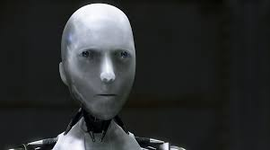

AI in Movies
1968
1984
2001
2004
2015

Slide 4
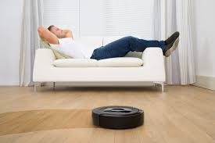
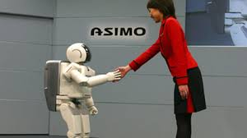
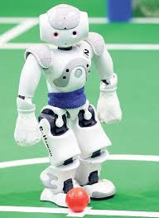
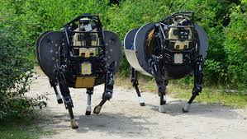
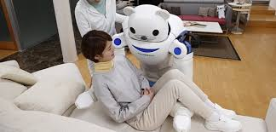
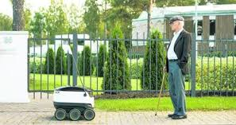
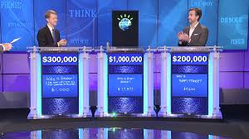
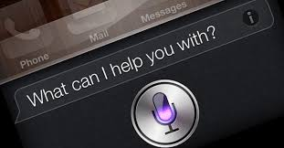
AI in the Media

Slide 5

Our Focus: Speech Recognition
der himmel war golden als hätte hanake eine ihrer truhen geöffnet die aus goldlack waren und die geheimfächer enthielten…
Wav2vec 2.0
German ASR
Clean Audio
Output Transcript
Wav2vec 2.0
German ASR
dmelwagolmen als hätte hadakereine invantüren geöffn sie auf volls lack war und die der heimfächer enthielt…
Noisy Audio
Output Transcript

Slide 6
Goal of the Projekt
Examine what ASR can do and what it can‘t do currently
Design a demonstrator for informing the general public
  Collect ideas for demonstrators
  Test feasibility
  Implement Demonstrator
  Install it in a public space as part of the TransforMA project

Slide 7
Project Plan
Conceptualization (25%): March – Mai 2023
  Learn about ASR
  Come up with Ideas for a demonstrator
2. Prototyping (50%): June – November 2023
  Test feasibility of different ideas
  Develop and test the most promosing one
3. Demonstration (25%): Deceber 2023 – February 2024
  Install and test a physical demonstrator at the Mafinex

Slide 8
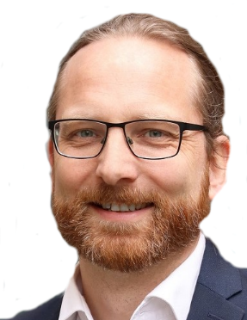
General Information
Language | English
Duration | 12 months
No of participants | 3-12
Pre-requisites | General AI/ML knowledge, Python
Contact person | Darshit Pandya (darshit.pandya@uni-mannheim.de) Heiner Stuckenschmidt (heiner.stuckenschmidt@uni-mannheim.de)

Slide 9
Executive Summary
This project is about the one topic students care about most:
Exam Preparation!!

Slide 10
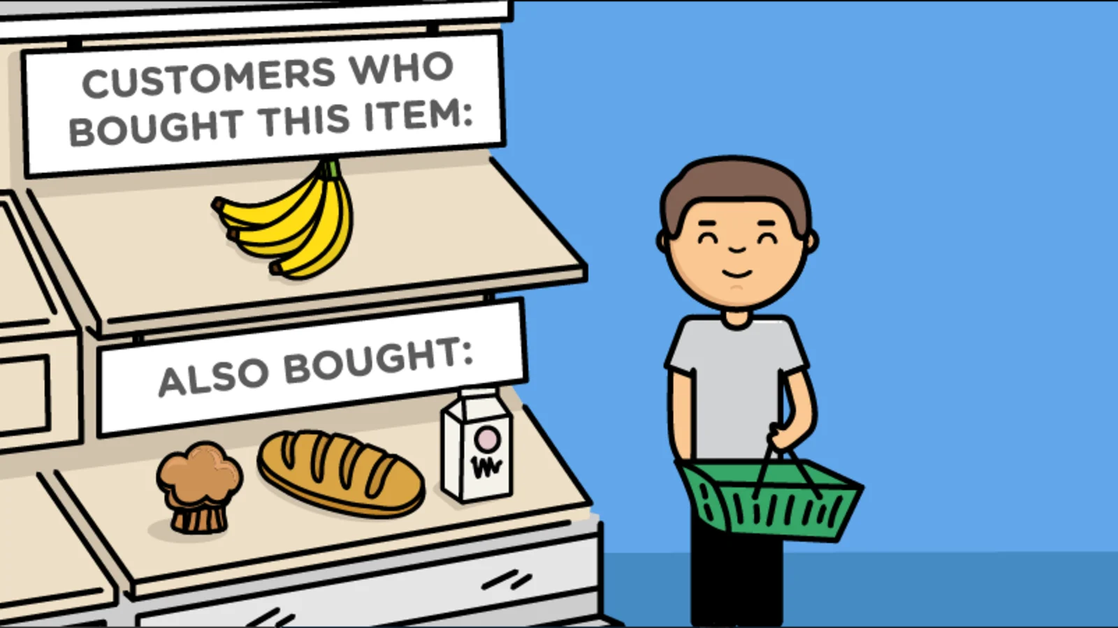
Extending ILIAS with an adaptive Content Recommender

Slide 11
Current Situation

Slide 12
Step 1: Annotate Exercises
Topics
Bayesian Networks
Joint Probabiliy
Distribution
Markov Blanket
Conditional
Independence
Difficulty:
Easy
Type:
Modelling
Computation
Application of
Definitions

Slide 13
Step 2: Extend ILIAS
Get used to ILIAS Code Base and Programming
Build a Module for Filtering relevant Exercises
Research Personalized Recommender Systems
Access User Data using LeAP
Klasen, D., & Ifenthaler, D. (2019). Implementing learning analytics into existing higher education legacy systems. In D. Ifenthaler, J. Y.-K. Yau, & D.-K. Mah (Eds.), Utilizing learning analytics to support study success (pp. 61–72). New York, NY: Springer.
Build a personalized Exercise Recommender

Slide 14
Step 3: Test in a real Lecture
Bachelor Cousre „Künstliche Intelligenz“
HWS 2023, 25 – 30 Participants
Topics:
  Problem Classes and Properties
  Problem Solving as Search
  Game Tree Search
  Constraint Satisfaction
  Logical Inference
  Decision Tree Learning

Slide 15
Project Tasks
First Semester:
Second Semester
Data Preparation
  Define Annotation Scheme
  Collect and Annotate Exercises
ILIAS Extension
  Learn how to Build ILIAS modules
  Look at the LeAP module
  Implement adaptable access to Exercises
Design and Build a content recommender for exercsies
Optional: Seminar on content recommendation (separate course)
Test System in the Lecture „Künstliche Intelligenz“

Slide 16
Project Setting
Teachers:
  Lea Cohausz (lea.cohausz@uni-mannheim.de)
  Heiner Stuckenschmidt
Language: German or English
Duration: 12 Months
Requirements:
  Basic German Language Skills and
  Profound Knowledge of the content of our Bachelor Lecture
  Künstliche Intelligenz (Problem Solving as Search).
Online Participation is possible

