Slide 1

Twitter Analysis Workbench
Joint Project with Prof. Heiko Paulheim & Katharina Ludwig

Slide 2

Project: Data-driven Analysis of Hate Speech on German Twitter and the Effects of Regulation
Social media provide new opportunities for social interactions and political participation. But they also facilitate the dissemination of extremist thoughts and aggressive or harassing contents.
→ Network Enforcement Act (NetzDG) in October 2017

Slide 3



Project: Data-driven Analysis of Hate Speech on German Twitter and the Effects of Regulation
Therefore we ask…
Is the Network Enforcement Act effective in lowering the prevalence of hateful content on social networks in Germany?
Are there changes in the prevalence of hate speech after Elon Musks take-over?
What is the prevalence of hate speech in discussions around topics such as Russia-Ukraine war, climate activism etc.?

Slide 4

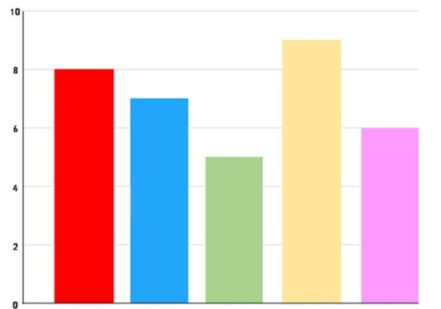


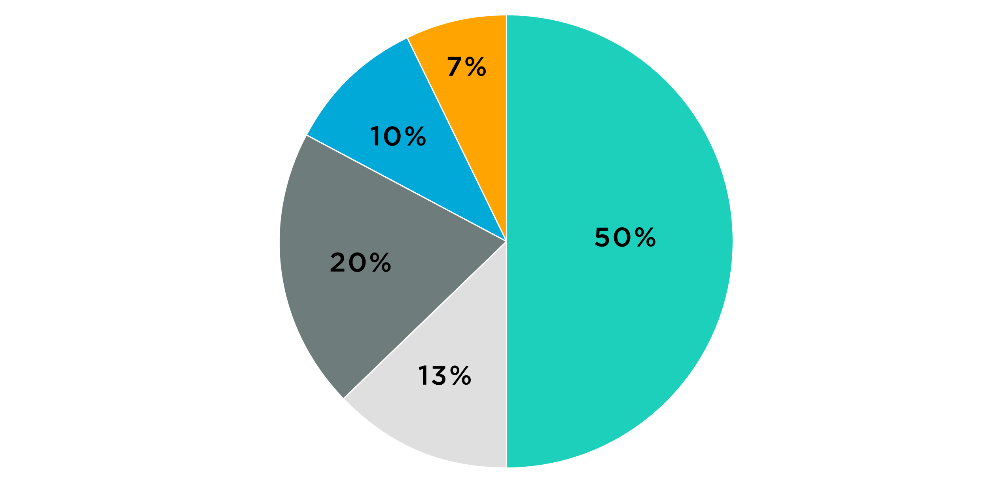
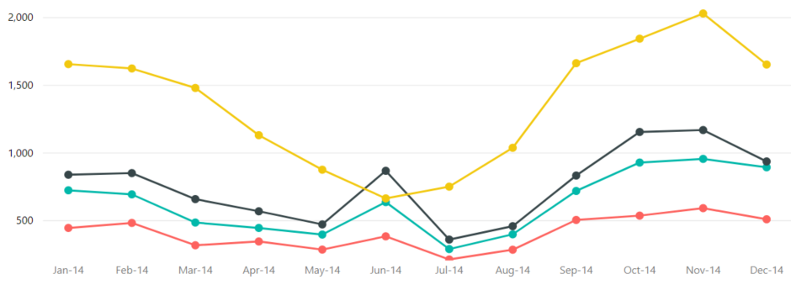
What We Want
A set of tools for…
  Collecting data from Twitter
  Analyzing data by different metrics
  Creating visualizations
analyze
collect
visualize
store

Slide 5
Your Tasks & Challenges
Overall goal: Develop useful tool(s) for data collection and analysis
Data collection & preprocessing
  API scraping (based on keywords, hastags, time frames etc.)
  Text & image extraction
Provide first analyses
  e.g., visualizations, sentiment analysis, network analysis, geographical breakdown…
Enrich data, e.g., with
  further classifications
  topic maps
  text embeddings
  identification and annotation of single claims
  …
Use enriched data for deeper analysis

Slide 6

Us…
Heiko Paulheim,
DWS
Katharina Ludwig, KOM

Slide 7
You…
...want to work on a project which has social relevance
...have profound knowledge in Python
...already attended Data Mining 1
....already attended or attend
  Text Analytics, IR+Web Search, or
  Web Mining
...are not afraid of Elon Musk‘s wild mood swings

