Slide 1
LASSO Grade – Grading Student Code Assignments Automatically
Team Project
FSS 2023

Slide 2
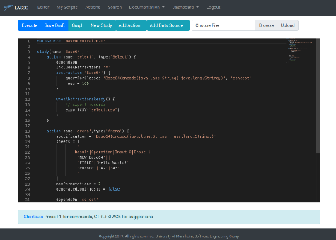
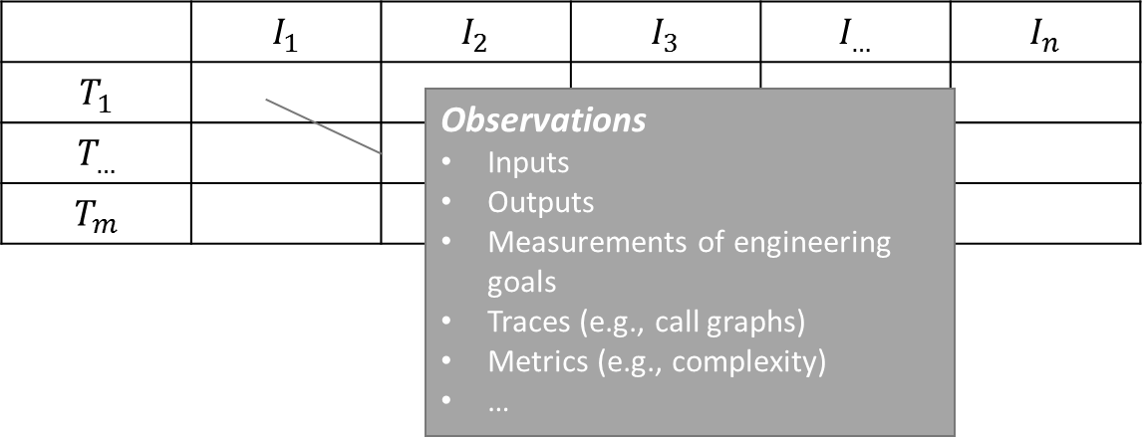
LASSO Platform: Search and Analyse “Big Code“
Large-Scale Software Observatorium
Assignments
Student Solutions
LSL Script
(mining tasks)
Test-Driven Code Search
Semantic “agnostic” & “specific” searches
Interface-based code search
Observation-based Behavior Analysis
Provide inputs (stimuli)
Data Analytics
Filtering (metrics, structural properties, code clones etc.)
Measurement of engineering goals etc.
Interactive analyses (notebook)
Offline analyses (external tools)
Observe outputs (responses)
Program analyses (static + dynamic)
Central
Executable Implementations
(Executable) software corpus
Serialize to and represent as data frames
SRMs
Stimuli/Response Matrices
Data-driven analysis

Slide 3
Goal
LASSO is a leading edge software observatorium that allows advanced search and analysis techniques to be applied to “big code”. Among other things, this simplifies experimentation and the validation of tools and software engineering approaches.
The goal of this team project is to realize LASSO Grade. This includes –
Import student solutions for code assignments (i.e., projects) into LASSO (e.g., crawling/indexing GIT repositories)
Setting up (reusable) analysis pipelines in LSL that enable automated scoring actions. This includes -
Plagiarism checks
Test-driven assessments (run tests provided by user)
Code Quality
Scoring model
Develop an intuitive web-based frontend for users that facilitates the use of LASSO Grade

Slide 4
Goal
Participants
6 students
Length
6 months
Required Skills
(Java) Programming
Data Analytics and data frame manipulation
Language
English
Organisation
Goals and timetable defined by agreement with the supervisor
Suitability
WiFO
MMDS
Supervisor
Marcus Kessel

