Slide 1

Study Abroad
Master Business Informatics
Mannheim Master of Data Science
Mannheim Master of Social Data Science

Slide 2

Study abroad
  All students have the opportunity to study abroad
  for one or two semesters
  without paying tuition fees
Credits: Sophie Henle

Slide 3

What for?
Don’t miss the unique opportunity to
  immerse yourself in another culture
  overcome challenges and gain new soft skills
  experience high-class education systems
  brush up your foreign language skills
  form lifelong friendships and international networks
  boost your CV and your career opportunities
  …

Slide 4
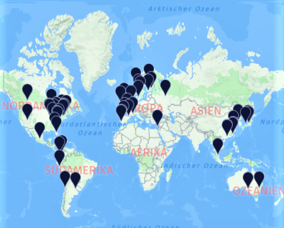
Where to?
  with over 450 partner universities in 60 countries you can choose from a variety of universities all around the globe
  70 of those are faculty-owned partner universities
  even lesser-known regions can become exciting destinations for your exchange!

Slide 5

First steps
  take a look at the different application deadlines, depending on your program of study and your host country
  take part in one of the mandatory Introductory Study Abroad Sessions right at the beginning of your studies
  look for suitable partner universities all around the globe

Slide 6


Application Deadlines
Exchange destinations and application deadlines are divided into two regions (the dates are examples for the semester abroad in 2025/2026):
Region | Deadline | Semester
Overseas North & South | 15 October 2024 | fall 2025 or spring 2026
Europe (without Russia) | 31 January 2025 | fall 2025 or spring 2026
Europe (remaining places) | 30 April 2025 | fall 2025 or spring 2026
Table for Master degrees starting in the fall term 2024.
If you want to travel to Overseas North in fall semester of 2025 or spring semester of 2026, you have to apply by 15 October 2024!

Slide 7
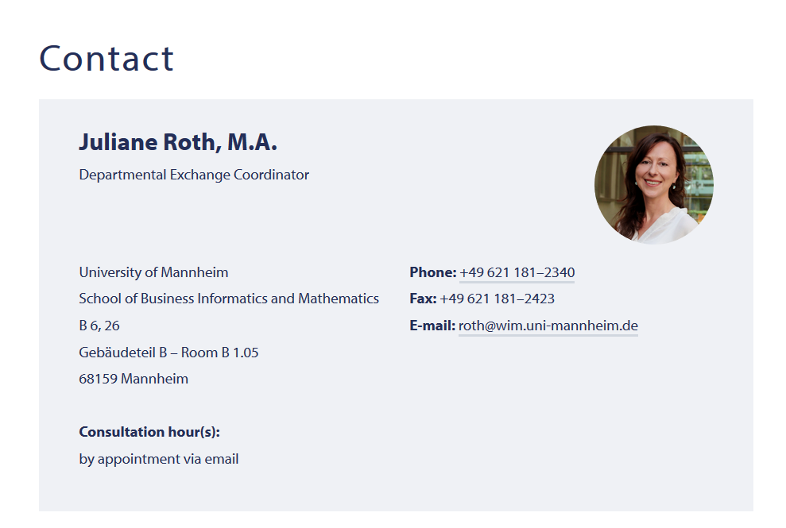
Studying Abroad Contact

