Slide 1

Studienorganisation
Master Business Informatics
Mannheim Master of Data Science
Mannheim Master of Social Data Science

Slide 2


Overview
Utensils
Degree Plan
Module Catalog
Portal
Milestones during your studies
Who to contact when?

Slide 3

Overview
Utensils
Degree Plan
Module Catalog
Portal
Milestones during your studies
Who to contact when?

Slide 4









Types of Modules (MMDS and M.Sc. Business Informatics)
Master’s Thesis
30 ECTS
Seminar
4 ECTS
Team Project/ Individual Project (only MMDS)
12 ECTS / 8 ECTS
Lectures and Projects
Scientific Research
2 ECTS
4

Slide 5
Types of Modules (MMSDS)
Master’s Thesis
30 ECTS
Lectures and Projects

Slide 6
Module Catalog
Module catalog officially declares
  offered courses
  their workload
  their credits
  required prerequisites
  …
Always refer to the most current Module Catalog and its Appendix
Business Informatics
MMDS
MMSDS

Slide 7
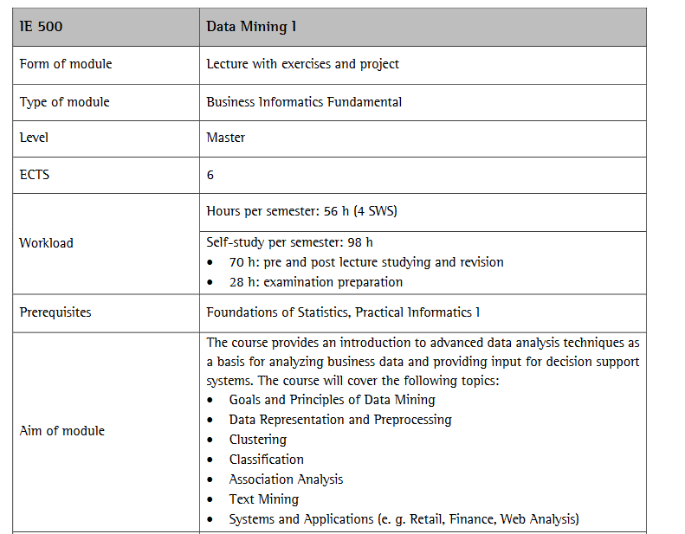
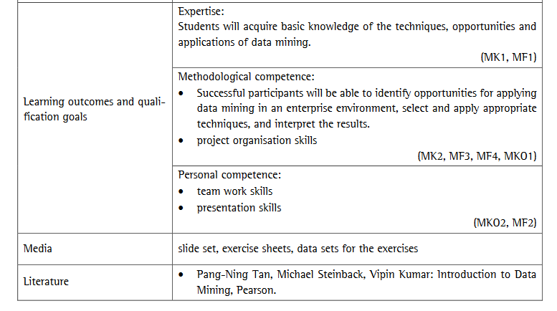
Module Catalog

Slide 8
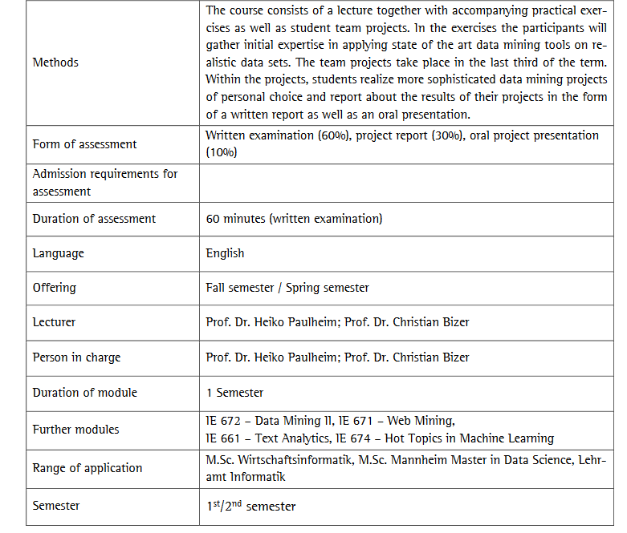
Module Catalog

Slide 9



Portal
Course Overview and registration
Overview of grades
Exam registration and deregistration
Information about institutions & campus life

Slide 10
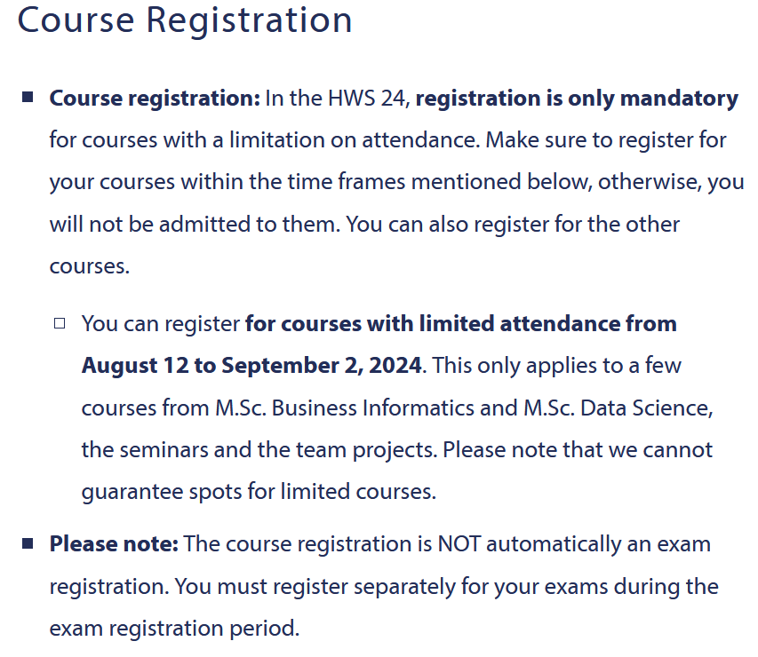
Portal – Course Registration
You only have to register for courses with limited attendance.
  Registration details will follow as soon as possible
  List can be found on our website https://www.wim.uni-mannheim.de/en/academics/information-about-the-start-of-the-semester/#c174022

Slide 11
Overview
Utensils
Degree Plan
Module Catalog
Portal
Milestones during your studies
Who to contact when?

Slide 12
Milestones
Projects, Seminar and Masters Thesis
Literature review
Programming
Writing

Slide 13

Milestones
Practice those skills from early on:
If you know that your programming skills are not solid, start practicing/learning now
If you cannot contribute to a team project, then it is very likely that you will not get a passing grade
If you have no programming skills, then it will be very difficult for you to find a Master‘s Thesis topic

Slide 14
Projects and Seminars
Only MMDS and M.Sc. Business Informatics
Seminar
4 ECTS
Team Project/ Individual Project
12 ECTS /
8 ECTS
Scientific Research
2 ECTS
PLEASE NOTE:
Each MMDS/Business Informatics student MUST take a Seminar and Scientific Research as well as a Team Project.

Slide 15

Projects and Seminars -
Team Projects
Only MMDS and M.Sc. Business Informatics
Team Project
12 ECTS /
12 ECTS, 1 or 2 semesters
Presentation in the beginning of the semester
Registration: portal² “Team Projects Master Wifo & MMDS”
Registration start and end will be announced as soon as possible
Registration is possible AFTER the presentation of the new Team Projects!

Slide 16

Projects and Seminars
Scientific Research Course
Only MMDS and M.Sc. Business Informatics
Scientific Research
2 ECTS
2 ECTS
Block seminar during the semester or in lecture-free period
Offered several times a year
Dates will be announced via mailing list

Slide 17

Seminars
Registration for CS-seminars via Portal² in the beginning of the semester (there will be an email).
You have to choose at least 3 priorities
IE- and IS-seminars have different application process
BUT: consider the requirements of each seminar

Slide 18

Masters Thesis
6 Months
Every chair has individual requirements that you have to fulfill to be considered
It is recommended to not write any exams during this period

Slide 19
Masters Thesis
In addition to the general information:
It is your own responsibility finding a supervisor
So, start early enough contacting relevant chairs
If you cannot find a supervisor after a relevant effort you can apply for our EMERGENCY-process.
But keep in mind: this is really for emergency and not Plan A to do!

Slide 20
Master‘s Thesis
How to find a supervisor and a topic:
Learn about relevant topics for a thesis in the lectures and especially the current and past seminars.
Ask the people giving those courses about possible topics.
Look at our websites for published lists of possible topics.
Create your own idea.
Start at the end of the 2nd semester to find a supervisor and a topic!
Find more information here:
https://www.wim.uni-mannheim.de/studium/studienorganisation/m-sc-business-informatics/#c109248
https://www.wim.uni-mannheim.de/studium/studienorganisation/mannheim-master-in-data-science/#c112252

Slide 21

Plagiarism
Plagiarism is when you copy someone else‘s work and do not give credit by referencing the source of the content.
This applies to:
Images, Text, Content structure, Code, …
We take this matter very serious!
You can fail the team project, the seminar or the Master‘s Thesis because of this

Slide 22
Time Limits
You SHOULD finish your studies within 4 semesters
You MUST finish within 7 semesters!

