Slide 1

Points of Contact
Master of Business Informatics
Mannheim Master of Data Science
Mannheim Master of Social Data Science

Slide 2
Master Mailing List
You will be added to the mmsds-/mmds-/wifo-master mailing list.
Please note: From now on, all email correspondence will go to your University of Mannheim email account!
Check your university mail account regularly!

Slide 3

Communication
Please use ONLY your university e-mail address in a university environment
Identify the right contact person
E-Mail to one person (if you want to write to more than one individual at once, put them in copy)
Requests must always include the following data: full name, course of study, subjects, semester and matriculation number.
Screenshots of IT issues
Keep to polite forms of communication (no chat communication!) - appropriate form of addressing and wording

Slide 4
Communication
Good idea | Bad idea
From: max.mustermann@students.uni-mannheim.de Dear Ms. Czanderle/Dear Sir or Madam, I have two questions regarding the organization of the upcoming semester. There is an overlap of two courses. IE 500 Data Mining Exercise I overlaps with the IE 675b Machine Learning lecture. The alternatives that would fit into my week would be the IE 650 Knowledge Graphs lecture or the CS 600 Model Driven Development lecture. Can you help me out with this? Kind regards, Max Mustermann Matriculation number: 123456 M.Sc. Business informatics (1st FS/1st FS) | From: gommemode@gmail.com Hello. ☺☺☺ I am studying business informatics here, what do I have to do? Bye, Max

Slide 5
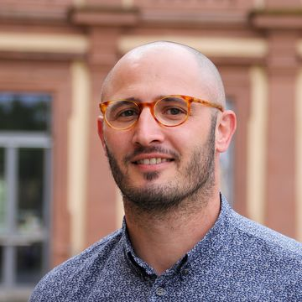
Student Services Office (Studienbüro 1)
  David Steiner (Student Services Office)
  studienbuero-wim@uni-mannheim.de
  Responsible for:
  Transcripts of records
  Registration and change in registration for exams
  Accepts a doctor´s note
  https://www.uni-mannheim.de/studium/im-studium/studienbueros/#c44366
  Express-Service: Ground floor of administrative building L 1,1
  https://www.uni-mannheim.de/studium/im-studium/studienbueros/#c44374

Slide 6
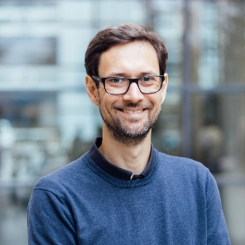
Examination Board of
Business Informatics
  Prof. Dr. Rainer Gemulla
  pruefungsausschuss.wim@uni-mannheim.de
  Responsible for:
  Studying abroad / Learning Agreements
  Acknowledgement of examinations
  Extension of time limits
  https://www.wim.uni-mannheim.de/studium/studienorganisation/m-sc-business-informatics/#c109246

Slide 7
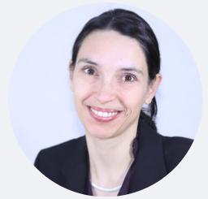
Examination Board of
MMDS
  Prof. Dr.-Ing. Margret Keuper
  pruefungsausschuss.wim@uni-mannheim.de
  Responsible for:
  Studying abroad / Learning Agreements
  Acknowledgement of examinations
  Extension of time limits
  https://www.wim.uni-mannheim.de/en/academics/organizing-your-studies/mannheim-master-in-data-science-starting-from-hws-2024/

Slide 8
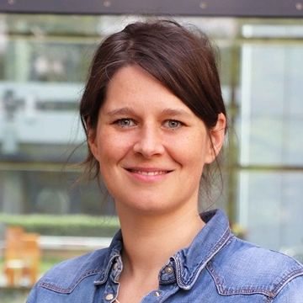
Program Manager (Studiengangsmanagement)
  Lisa Wessa
  lisa.wessa@uni-mannheim.de
  Responsible for:
  Module catalogue
  Courses in Portal
  Curriculum

Slide 9
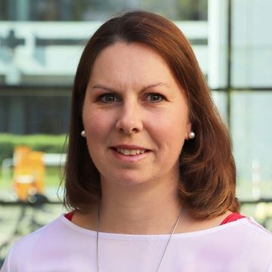
Academic Advisor and Study Coach (Studienberatung)
  Birgit Czanderle
  pruefungsausschuss.wim@uni-mannheim.de
  studienberatung.wim@uni-mannheim.de
  Responsible for:
  Questions about the examination regulations (e.g. extensions, learning agreements, recognition of prior learning)
  Your study plan (modules, thesis)
  Consulting in cases of hardship

Slide 10
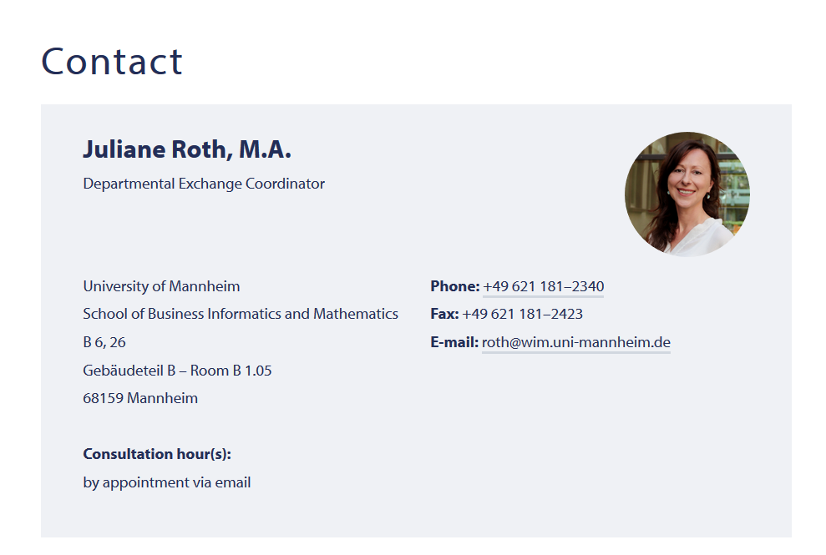
Studying Abroad Contact

Slide 11
Important Links
Student Council (FIM)
  fim.uni-mannheim.de
School of Business Informatics and Mathematics
  www.wim.uni-mannheim.de
Studienbüros
  https://www.uni-mannheim.de/studium/im-studium/
Portal²
  www.portal2.uni-mannheim.de
ILIAS
  www.ilias.uni-mannheim.de

Slide 12

Last but not least – Mailing List
You will be added to our mailing list.
All email correspondence will from now on go to your University of Mannheim email account!
We ask you to contact us only with your uni email address due to legal reasons.
These slides will be available for download on our website
www.wim.uni-mannheim.de

