Slide 1

Social Data Science
Mannheim Master of Social Data Science

Slide 2
Program facts and information
Degree: Master of Science (M.Sc.)
Standard period of study: 4 Semester
Maximum period of study: 7 Semester
ECTS credits: 120
Language of instruction: English
School: School of Business Informatics and Mathematics
Module catalog: can be found here

Slide 3
Structure of the M.Sc. Program
Foundations of Data Science
5 modules
Data Science Methods: Fundamentals
3 Modules
Data Science Applications
Modules with
Data Science Methods: Specializations
Modules with
27 ECTS
18 - 23 ECTS
27 ECTS
18 – 23 ECTS
total of
total of
Master’s Thesis
30 ECTS

Slide 4
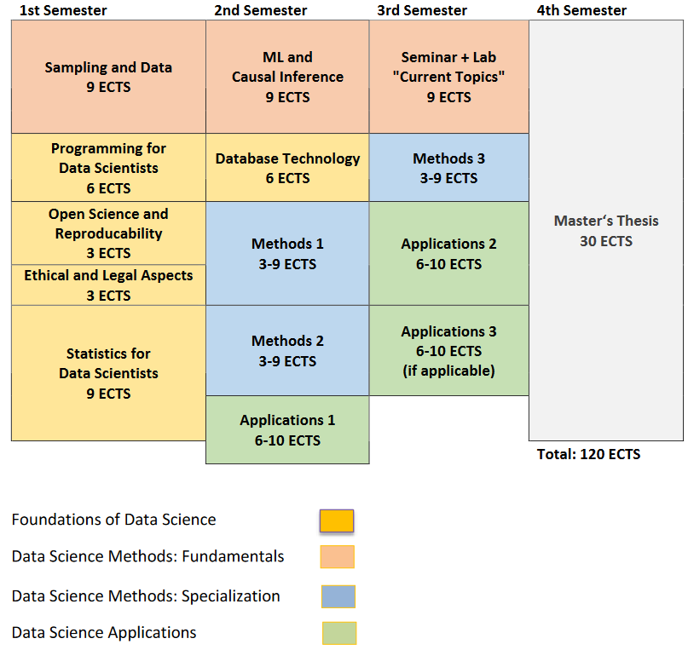
Example Study Plan

Slide 5
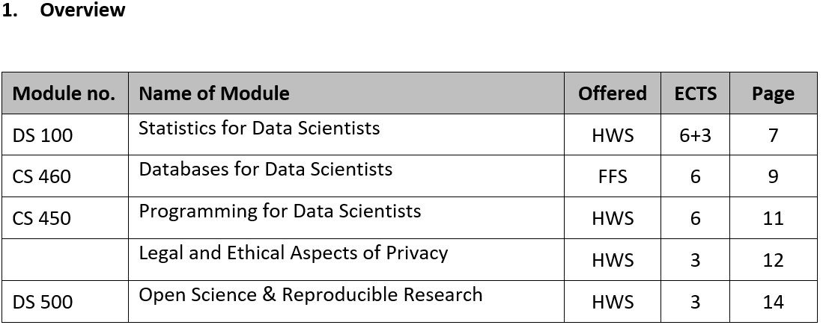
Structure of the M.Sc. Program
Foundations of Data Science

Slide 6
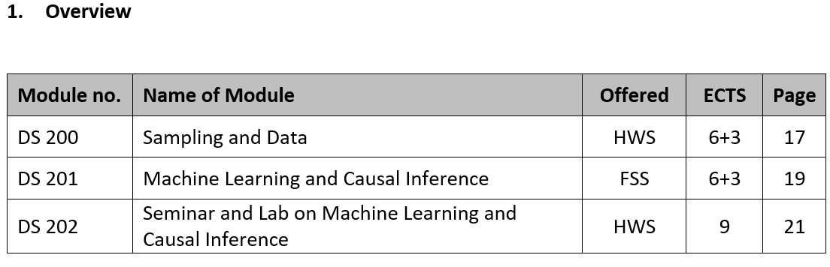
Structure of the M.Sc. Program
Data Science Methods: Fundamentals

Slide 7
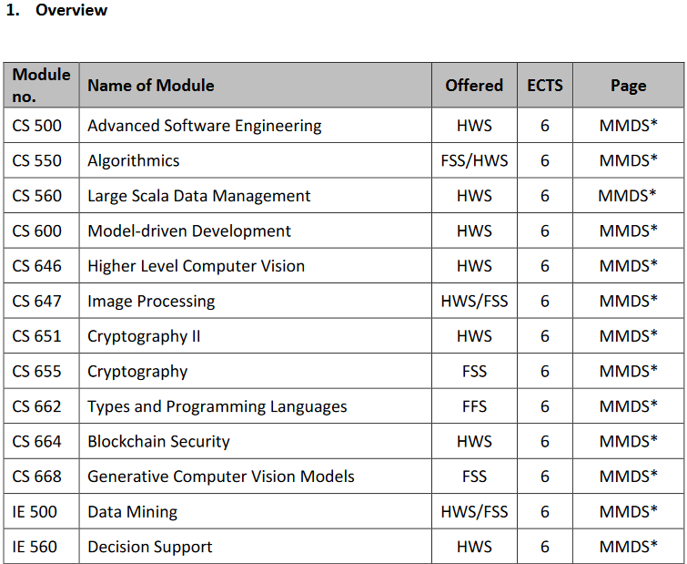
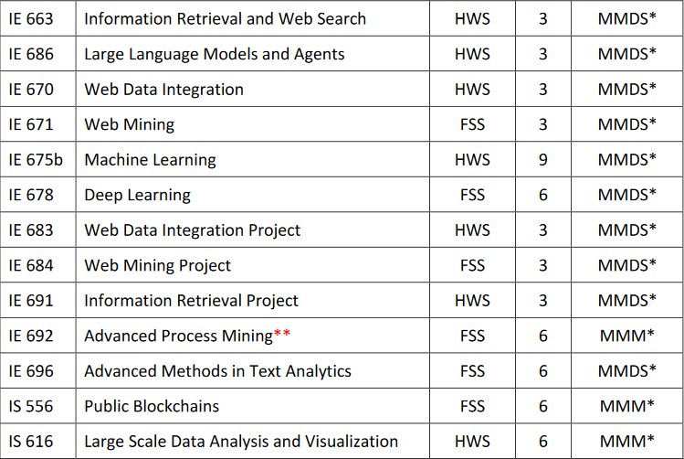
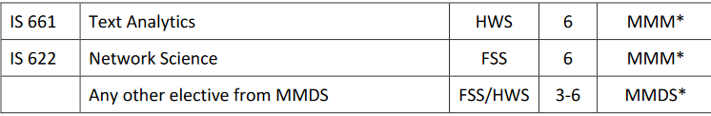
Structure of the M.Sc. Program
Data Science Methods: Specializations
* For a detailed description, please see the module catalogs of the respective following degree programs:
• MMDS: Mannheim Master in Data Science
https://www.wim.uni-mannheim.de/en/academics/organizing-your-studies/mannheim-master-in-data-science/#c112237
(only courses form the modules “Data Management” and “Data Analytics Methods” are allowed
• MMM: Mannheim Master in Management
https://www.bwl.uni-mannheim.de/en/module-catalog-mmm/
**The number of this module will change (TBA)

Slide 8
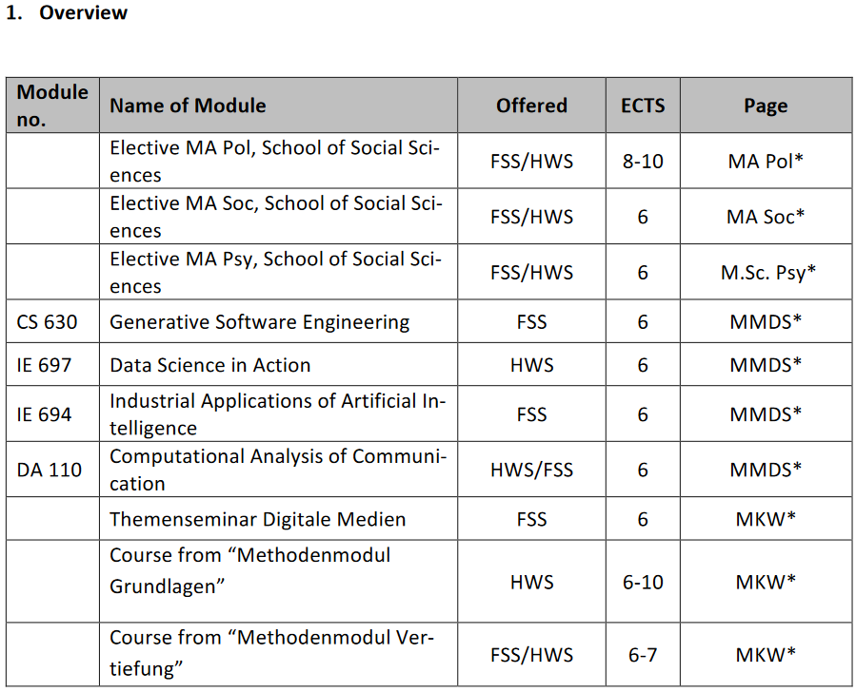
Structure of the M.Sc. Program
Data Science Applications
* For a detailed description, please see the module catalogs of the respective following degree programs:
• MA Pol: Master of Arts in Political Science
https://www.sowi.uni-mannheim.de/studium/studierende/politikwissenschaft/ma-political-science/#c200577
• MA Soc: Master of Arts in Sociology
https://www.sowi.uni-mannheim.de/studium/studierende/soziologie/ma-sociology/#c317505
• M.Sc. Psy: Master of Science Psychologie - Arbeit, Wirtschaft, Gesellschaft (only in German)
https://www.sowi.uni-mannheim.de/en/academics/students/psychology/msc-in-psychology-work-economy-and-society/#c90178
• MMDS: Mannheim Master in Data Science
https://www.wim.uni-mannheim.de/en/academics/organizing-your-studies/mannheim-master-in-data-science/#c112237
• Master Medien und Kommunikationswissenschaft
https://www.phil.uni-mannheim.de/studium/modulkataloge/#c111078

