Slide 1
Introductory Session Mannheim Master in Data Science
Notes:
Welcome to University and our Faculty
Any english only guys???
Self Introduction
Introduce Jana
Some more detailed information about your study program

Slide 2
Data Science in a Nutshell
Global Data Volume
Estimated 3.3 Zetta Byte / Year for 2021
≈22,000 full length movies on DVD per second
Challenges
Data collection
Storage
Processing
Analysis
Social Impact

Slide 3
Data Science in the Recent News
False alarm detection in intensive care
e.g., ETH Zurich, January 2019
Problem Setting
Data Science Solution
700 alarms per patient and day
(every 2 minutes)
→ many of those are false alarms
Collect data
Computer distinguishes false/real alarms
Lower workload

Slide 4
Data Science in the Recent News
Recruiting
e.g. System
by IBM based on WATSON, June 2018
Problem Setting
Data Science Solution
Recruiters get lots of (different) applications
Recruiters need to seek actively
Collect postings & applications
Match & Create shortlists
Automate communication

Slide 5
Data Science in the Recent News
Jurisdiction
e.g., University of Toulouse, January 2019
Problem Setting
Data Science
Solution
Judges never unbiased
influences: mood, weather, wins/losses of favorite team
Gather cases and decisions
Predict typical decision & watch for deviations
Find Patterns involving irrelevant factors

Slide 6
Data Science in the Recent News
Mental Health
e.g., Facebook Research, September 2018
Problem Setting
Data Science
Solution
Find out whether a person is going to harm themselves
There might be subtle signals
Watch people‘s behavior on social network
Identify typical patterns for mentally unstable persons
Call 911

Slide 7
New Technologies and
New Questions
But would you…
…put your life in the hands of algorithms?
…want your career influenced by a computer?
…prefer to be judged by a human or a machine?
...give all your data to Facebook?

Slide 8
Master in Data Science
Social Science
Interdisciplinary
Computer Science
Mathematics & Statistics
Social Science
Applied
Hands-on experience
Close cooperation with industry partners
Computer
Science
Mathematics & Statistics
Notes:
DS as Interdisciplinar Topic range
Main characteristic of Mannheim Data Science Master, manages to capture this interdisciplinarity really good
Cooperation with other faculties and the chairs of mathematics which are included in our faculty
Also really applied study program, many project works (in multiple lectures [like dm, web mining, wdi, … and teamproject)

Slide 9
Structure of the M.Sc. Program
Fundamentals
Maximum of two modules
Data Management
Minimum of three modules
Data Analytic Methods
Minimum of four modules
Responsible Data Science
Minimum of one module
0 - 14 ECTS
30 - 54 ECTS
18 - 36 ECTS
3 – 10 ECTS
Projects and
Seminars
14-18 ECTS
Master’s Thesis
30 ECTS
Notes:
Study program splitted up in several parts, thus extensive education over the whole data science field
But still, it allows you great latitute
No exact amount of credits assigned to each part
I will go deeper into the singe parts

Slide 10
Structure of the M.Sc. Program
Fundamentals
Programming Course
6 ECTS
Database Technology
6 ECTS
Multivariate Analyses
6 ECTS
Empirische Methoden der Politikwissenschaft
6 ECTS
Tutorial Multivariate Analyses
2 ECTS
Notes:
Interdisciplinary → everyone has a different background (social, computer science, math, …)
Depending on background you can choose fundamentals to catch up on topics that are required for further courses and lectures.
Attention: Many students gave the feedback that fundamentals are considered laborious – but still helpful
Not obligatory! It‘s up to you! You‘re reponsible yourself for the success of your studies!

Slide 11
Structure of the M.Sc. Program
Data Management
Module no. | Name of module | ECTS
CS 500 | Advanced Software Engineering | 6
CS 530 | Database Systems II | 6
CS 560 | Large Scale Data Management | 6
CS 600 | Model-driven Development | 6
IE 630 | Query Optimization | 6
IE 650 | Semantic Web Technologies | 6
IE 663 | Information Retrieval and Web Search | 3
IE 670 | Web Data Integration | 3
IE 691 | Information Retrieval Project | 3
IE 683 | Web Data Integration Project | 3

Slide 12
Structure of the M.Sc. Program
Data Analytic Methods
M.A. Political Science
M.Sc. Business Informatics
M.Sc. Mathematics in Business and Economics
M.A. Sociology
Higher Level Computer Vision
Image Processing
Data Mining I
Mathematics & Information
Computational Finance
Advanced Quantitative Methods
Longitudinal Data Analysis
Research Design
Cross Sectional Data Analysis
Notes:
Courses not offered by our faculty may need application!
If you‘re interested, check asap via portal2, google for the lecture, …

Slide 13
Structure of the M.Sc. Program
Responsible Data Science
Without Prejudice - Avoiding unfair conclusions even if they are true
Without Speculation - Answering questions with a guaranteed level of accuracy
Ensuring discretion – Answering questions without revealing secrets
Providing transparency - Clarifying answers such that they become indisputable
Business
Administration
*redasci.org

Slide 14
Structure of the M.Sc. Program
Projects and Seminars
Seminar
4 ECTS
Team Project
or Individual Project
12 ECTS / 8 ECTS
Scientific Research
2 ECTS
Notes:
More practical part
Team project / individual project – mail about team project introduction? Next week Tuesday 12am
Individual project: May be done in cooperation with a company or if you have a topic you can always propose it to a professor
Seminars: Recommend to do it later, earliest in 2nd semester, can be seen as preparation for the masters thesis – scientific working
Scientific research: new in examination regulation,

Slide 15
Structure of the M.Sc. Program
Master’s Thesis
6 Months
Every chair has individual requirements that you have to fulfill to be considered
It is recommended to not write any exams during this period
Notes:
Last but not least – master thesis
Seems to be far away but time goes by really fast…
So from the beginning of your studies: Try to decide which way you want to go, which topic or chair may be interessant for you to write your thesis
Check with the prof or chair for any individual requirements
Recommendation: Exams, Team Project and anything not in the semester of thesis – so in the first 3 semesters if you want to end in regular period of studies.

Slide 16
MMDS Mailing List
You will be added to the mmds emailing list.
Please note: All email correspondence from now on will go to your Uni Mannheim email account!
→ Check your university mail account regularly!

Slide 17
Important Webpages
wim.uni-mannheim.de
Info about study organization (module catalogue, examination regulation, contacts, …)
uni-mannheim.de/dws
Info about professors from our faculty related to data science
Detailed course information (regarding content and organization)
dief.im
Student association Homepage

Slide 18
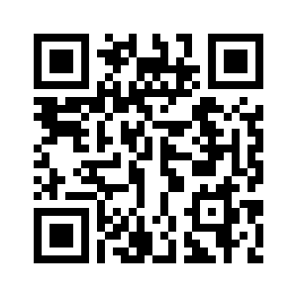
Students‘ Communication Channels
There are also communication channels run by your fellow students
Slack Channel
mmds-students.slack.com
Use Firstname_Lastname as displayed username
WhatsApp group
scan the QR code now!

Slide 19
Who do you contact when?

Slide 20
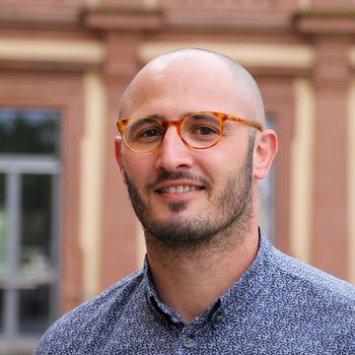
Student Services Office (Studienbüro 1)
David Steiner (Student Services Office)
steiner@verwaltung.uni-mannheim.de
Responsible for:
Transcripts of records
Registration and change in registration for exams
Accepts a doctor´s note
https://www.uni-mannheim.de/studium/im-studium/studienbueros/#c44366
Express-Service: Ground floor of administrative building L 1,1
https://www.uni-mannheim.de/studium/im-studium/studienbueros/#c44374

Slide 21
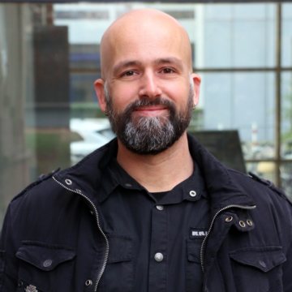
Examination Board of MMDS
Prof. Dr. Heiko Paulheim
pruefungsausschuss@wim.uni-mannheim.de
Responsible for:
Studying abroad / Learning Agreements
Acknowledgement of examinations
Extension of time limits
https://www.wim.uni-mannheim.de/studium/studienorganisation/m-sc-business-informatics/#c109246

Slide 22
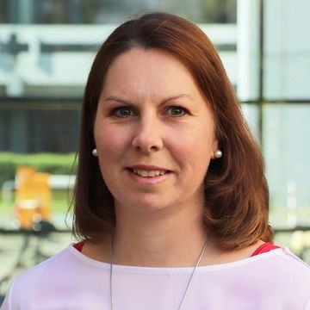
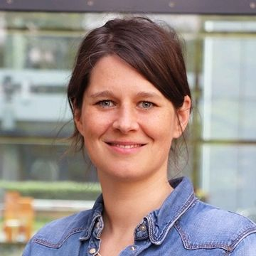
Student Track Manager (Studiengangsmanagement)
Birgit Czanderle
Lisa Wessa (from January 2021)
czanderle@wim.uni-mannheim.de
Responsible for:
Module catalogue
Courses in Portal
Curriculum

Slide 23
Academic Advisor and Study Coach (Studienberatung)
Birgit Czanderle
studienberatung@wim.uni-mannheim.de
Responsible for:
Questions about the examination regulations (e.g. module changes, extensions)
Your study plan (modules, thesis)
Consulting in cases of hardship

Slide 24
Thank you for your attention!
Questions?

